Slide 1

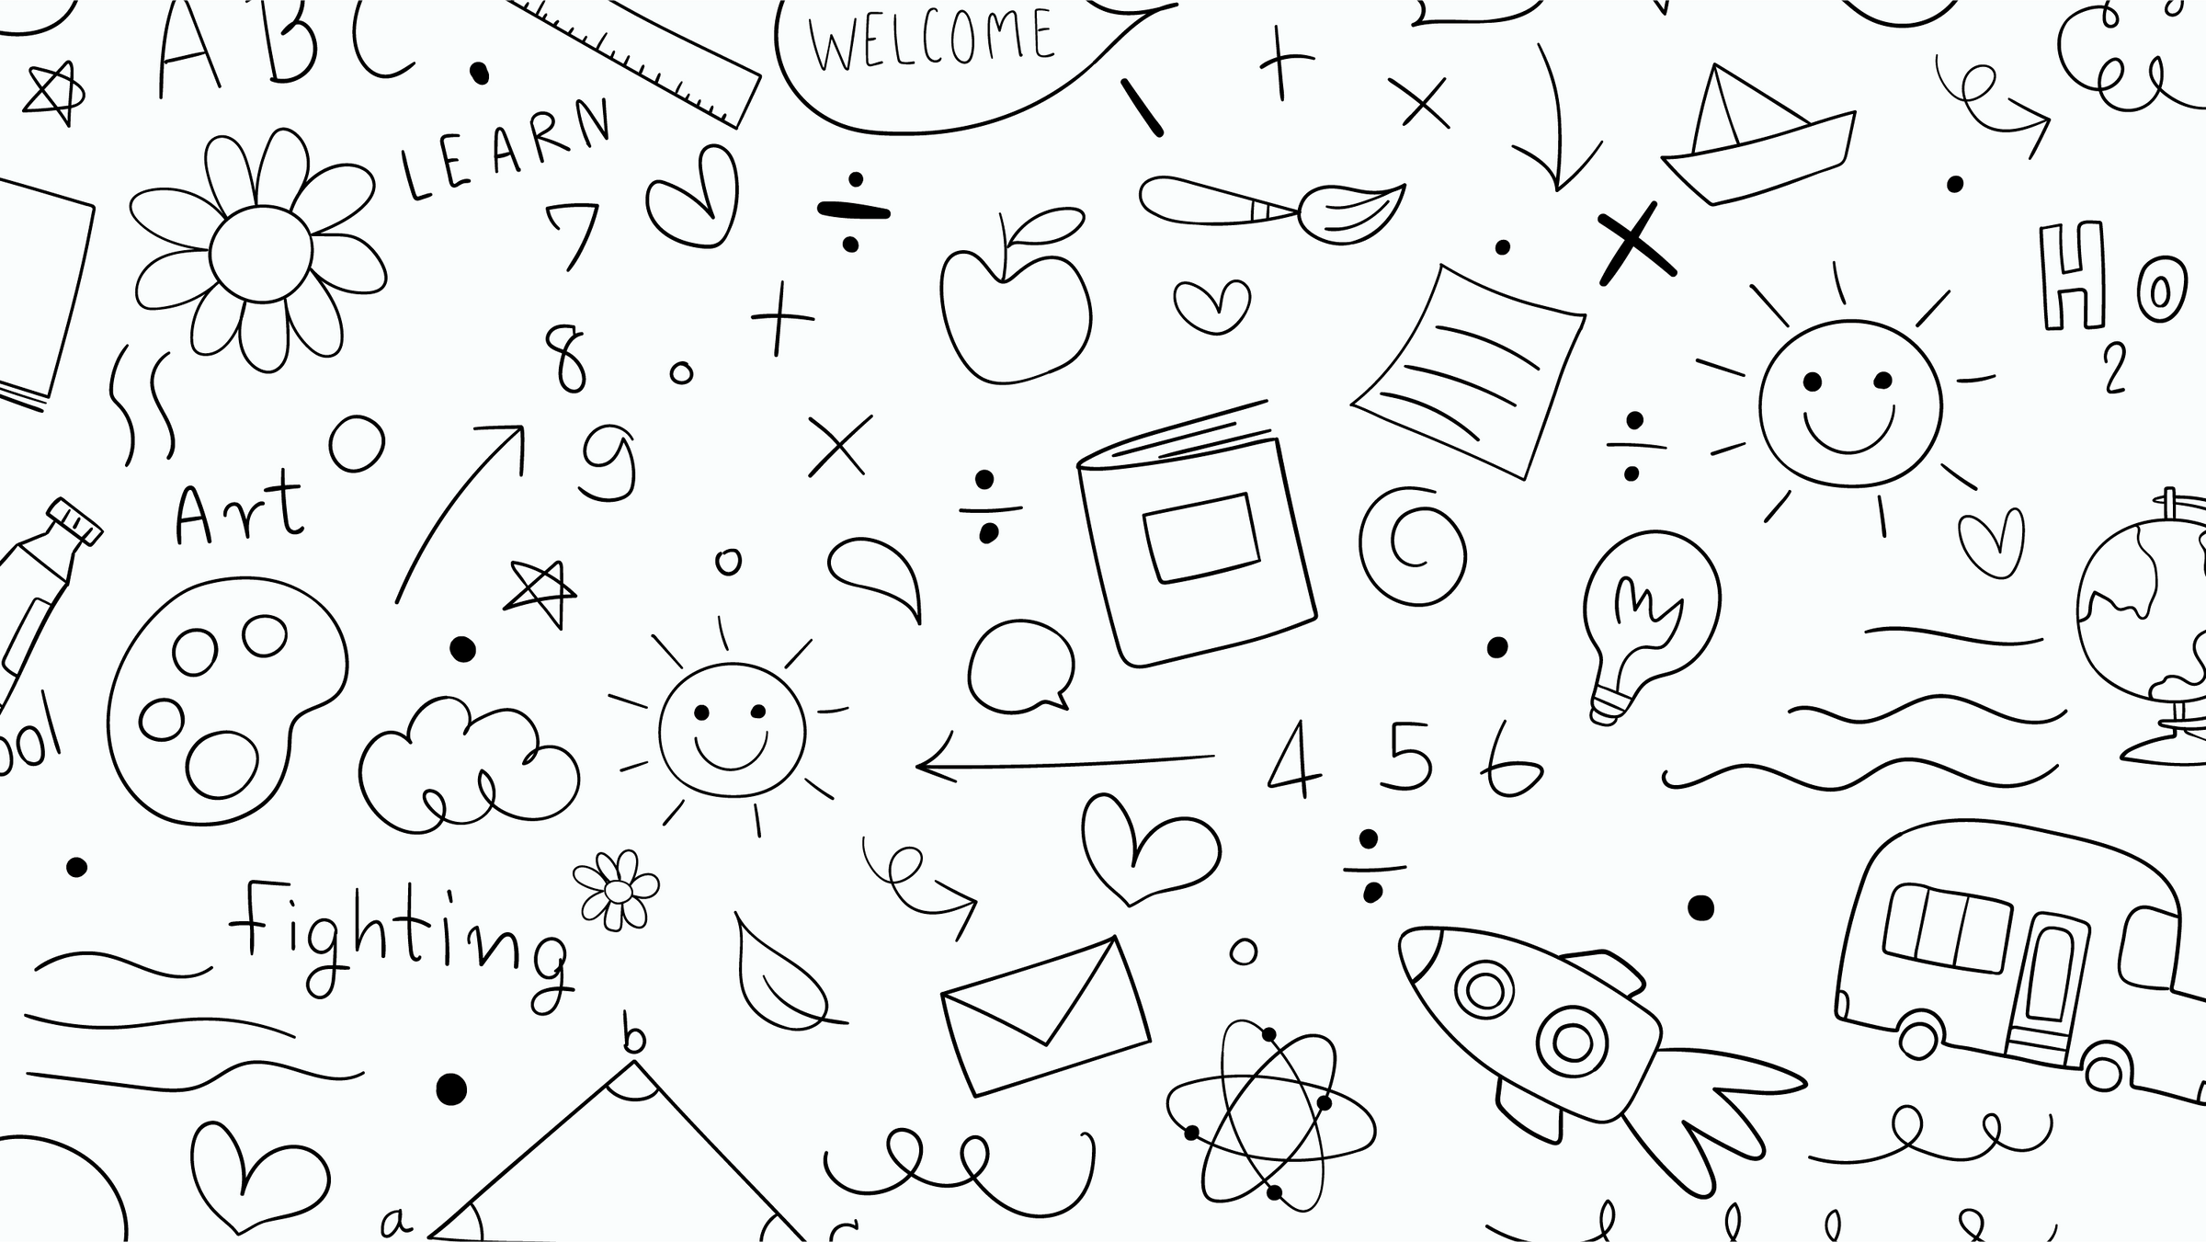

TRANSPORT AND COMMUNICATION
By Sanskriti
www.vaagaacademy.com

Slide 2
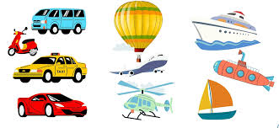
WHAT IS TRANSPORT?
Transport means moving people or goods from one place to another. 👶 We use transport to go to school, visit places, or travel far away! There are 3 types of transport:
🚗 Land Transport
✈️ Air Transport
🚢 Water Transport

Slide 3
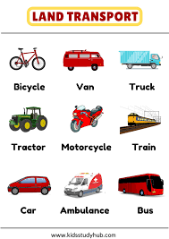
LAND TRANSPORT
Land transport runs on roads or rails. Examples:
🚗 Car – For small families
🚌 Bus – Many people travel together
🚂 Train – Runs on tracks, good for long distances
🚲 Bicycle – Eco-friendly and cheap
💡 Quiz Tip: Bicycle is the least expensive means of transport!

Slide 4
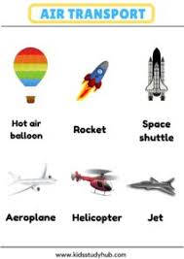
AIR TRANSPORT
Air transport moves through the sky. Examples:
✈️ Aeroplane – Fastest way to travel far
🚁 Helicopter – Can land anywhere, even on buildings
🌍 Olympiad Tip: To travel from Australia to Europe, use an aeroplane – it's the fastest!

Slide 5
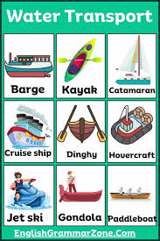
WATER TRANSPORT
Water transport moves on rivers, lakes, or oceans. Examples:
🚢 Ship – Carries heavy goods across seas
🛶 Boat – Used on rivers or small lakes
💡 Quiz Tip: Boat is different from cars and buses. It’s a water transport, not land!

Slide 6
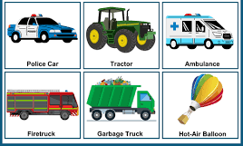
SPECIAL TRANSPORT
Some vehicles are used in special places:
🚜 Tractor – Used on farms to plough or carry things
🚒 Fire Truck – Used during emergencies
🚑 Ambulance – Helps sick people reach the hospital
🧠 Olympiad Tip: Tractors are used on farms!

Slide 7
PUBLIC AND PRIVATE
Public Transport = Many people use it (e.g., 🚌 bus, 🚇 metro) Private Transport = For personal use (e.g., 🚗 car, 🛵 scooter)
✅ Olympiad Tip: Both buses and the metro are public transport!

Slide 8
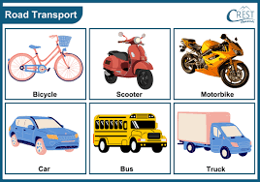
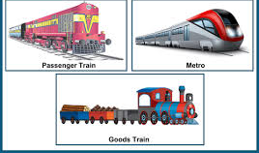

Slide 9
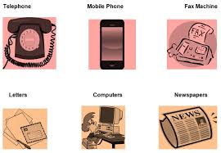
WHAT IS COMMUNICATION?
Communication means sharing messages, ideas, or feelings. We can do this by:
📞 Talking
💬 Writing
📧 Sending messages or emails

Slide 10
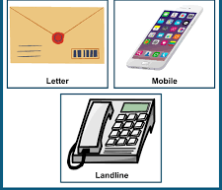
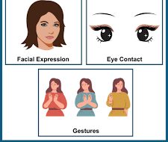
TYPES OF COMMUNICATION
There are 2 main types:
📞 Verbal Communication
Talking, using words or sounds
Example: phone call, talking to a friend
📝 Non-Verbal Communication
Using signs, pictures, or gestures
Example: emojis, traffic signals, facial expressions

Slide 11
HOW WE COMMUNICATE TODAY?
🖼️ Visual – Pictures, charts, signs 🔊 Audio – Radio, phone 💻 Digital – WhatsApp, Email, Video calls 📫 Postal – Letters, postcards
🔍 Quiz Practice:
📧 Email is digital
📨 Letter is postal

Slide 12
COMMUNICATION TOOLS
Old | New
Letter | Email
Landline Phone | Mobile Phone
Newspaper | Television, Internet
Old and New Communication:
💡 Tip: Both TV and Internet can give news!

Slide 13
WHY IMPORTANT?
Transport helps us:
Travel to school and work
Send goods across countries
Visit family and friends
💬 Communication helps us:
Stay in touch with others
Share knowledge and news
Learn and have fun online

Slide 14
